Slide 1
Phase 1 Listening Session
Thursday, December 5, 2024
Fond du Lac Tribal and Community College

Slide 2
Project Information
The Munger Trail Connection project is being led by the Fond du Lac Band of Lake Superior Chippewa.
Public input plays an important role in the development of preliminary trail designs.
The listening sessions held on December 5th displayed information on:
  How to provide input.
  Trail options for 5 different segments of the proposed trail connection.
  Frequently asked questions.
The following slides contain the exhibits displayed at the listening session.

Slide 3
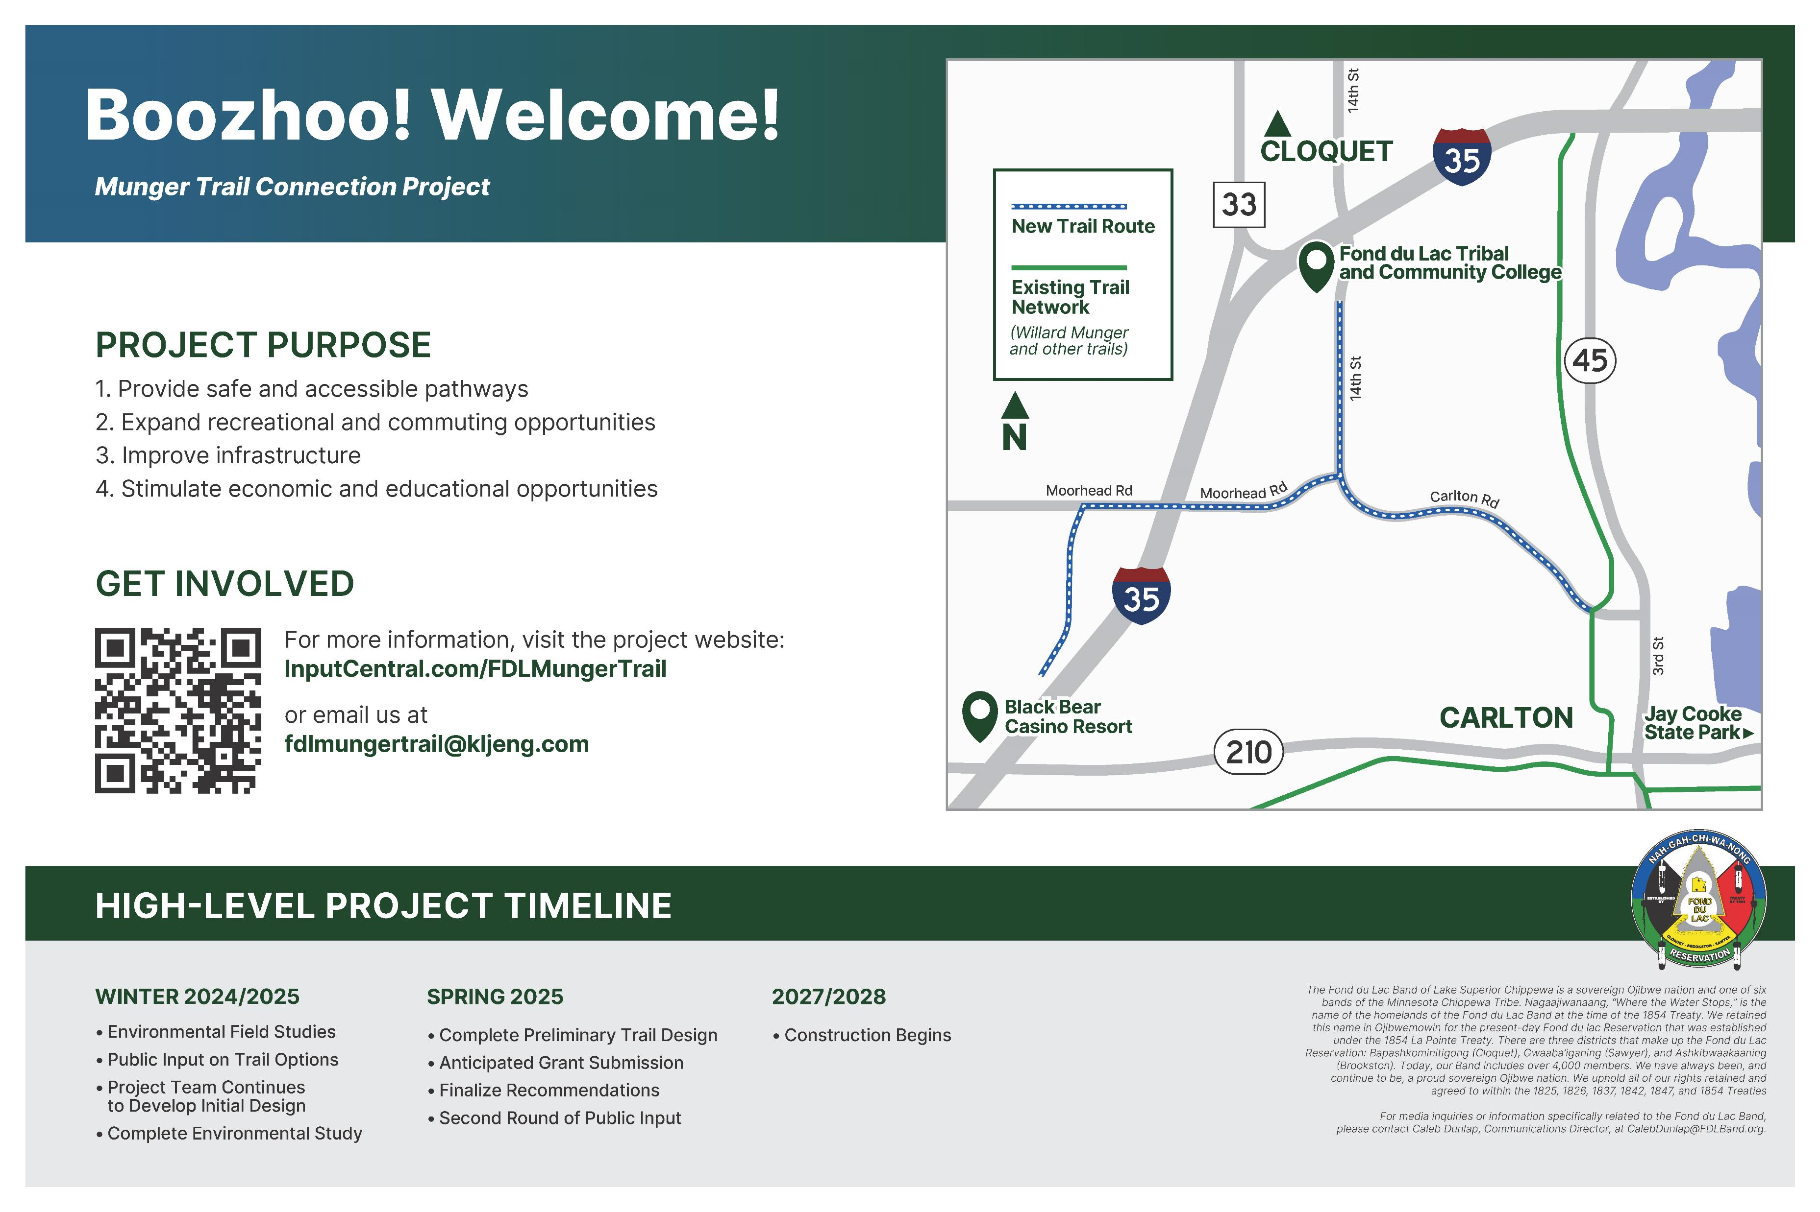

Slide 4
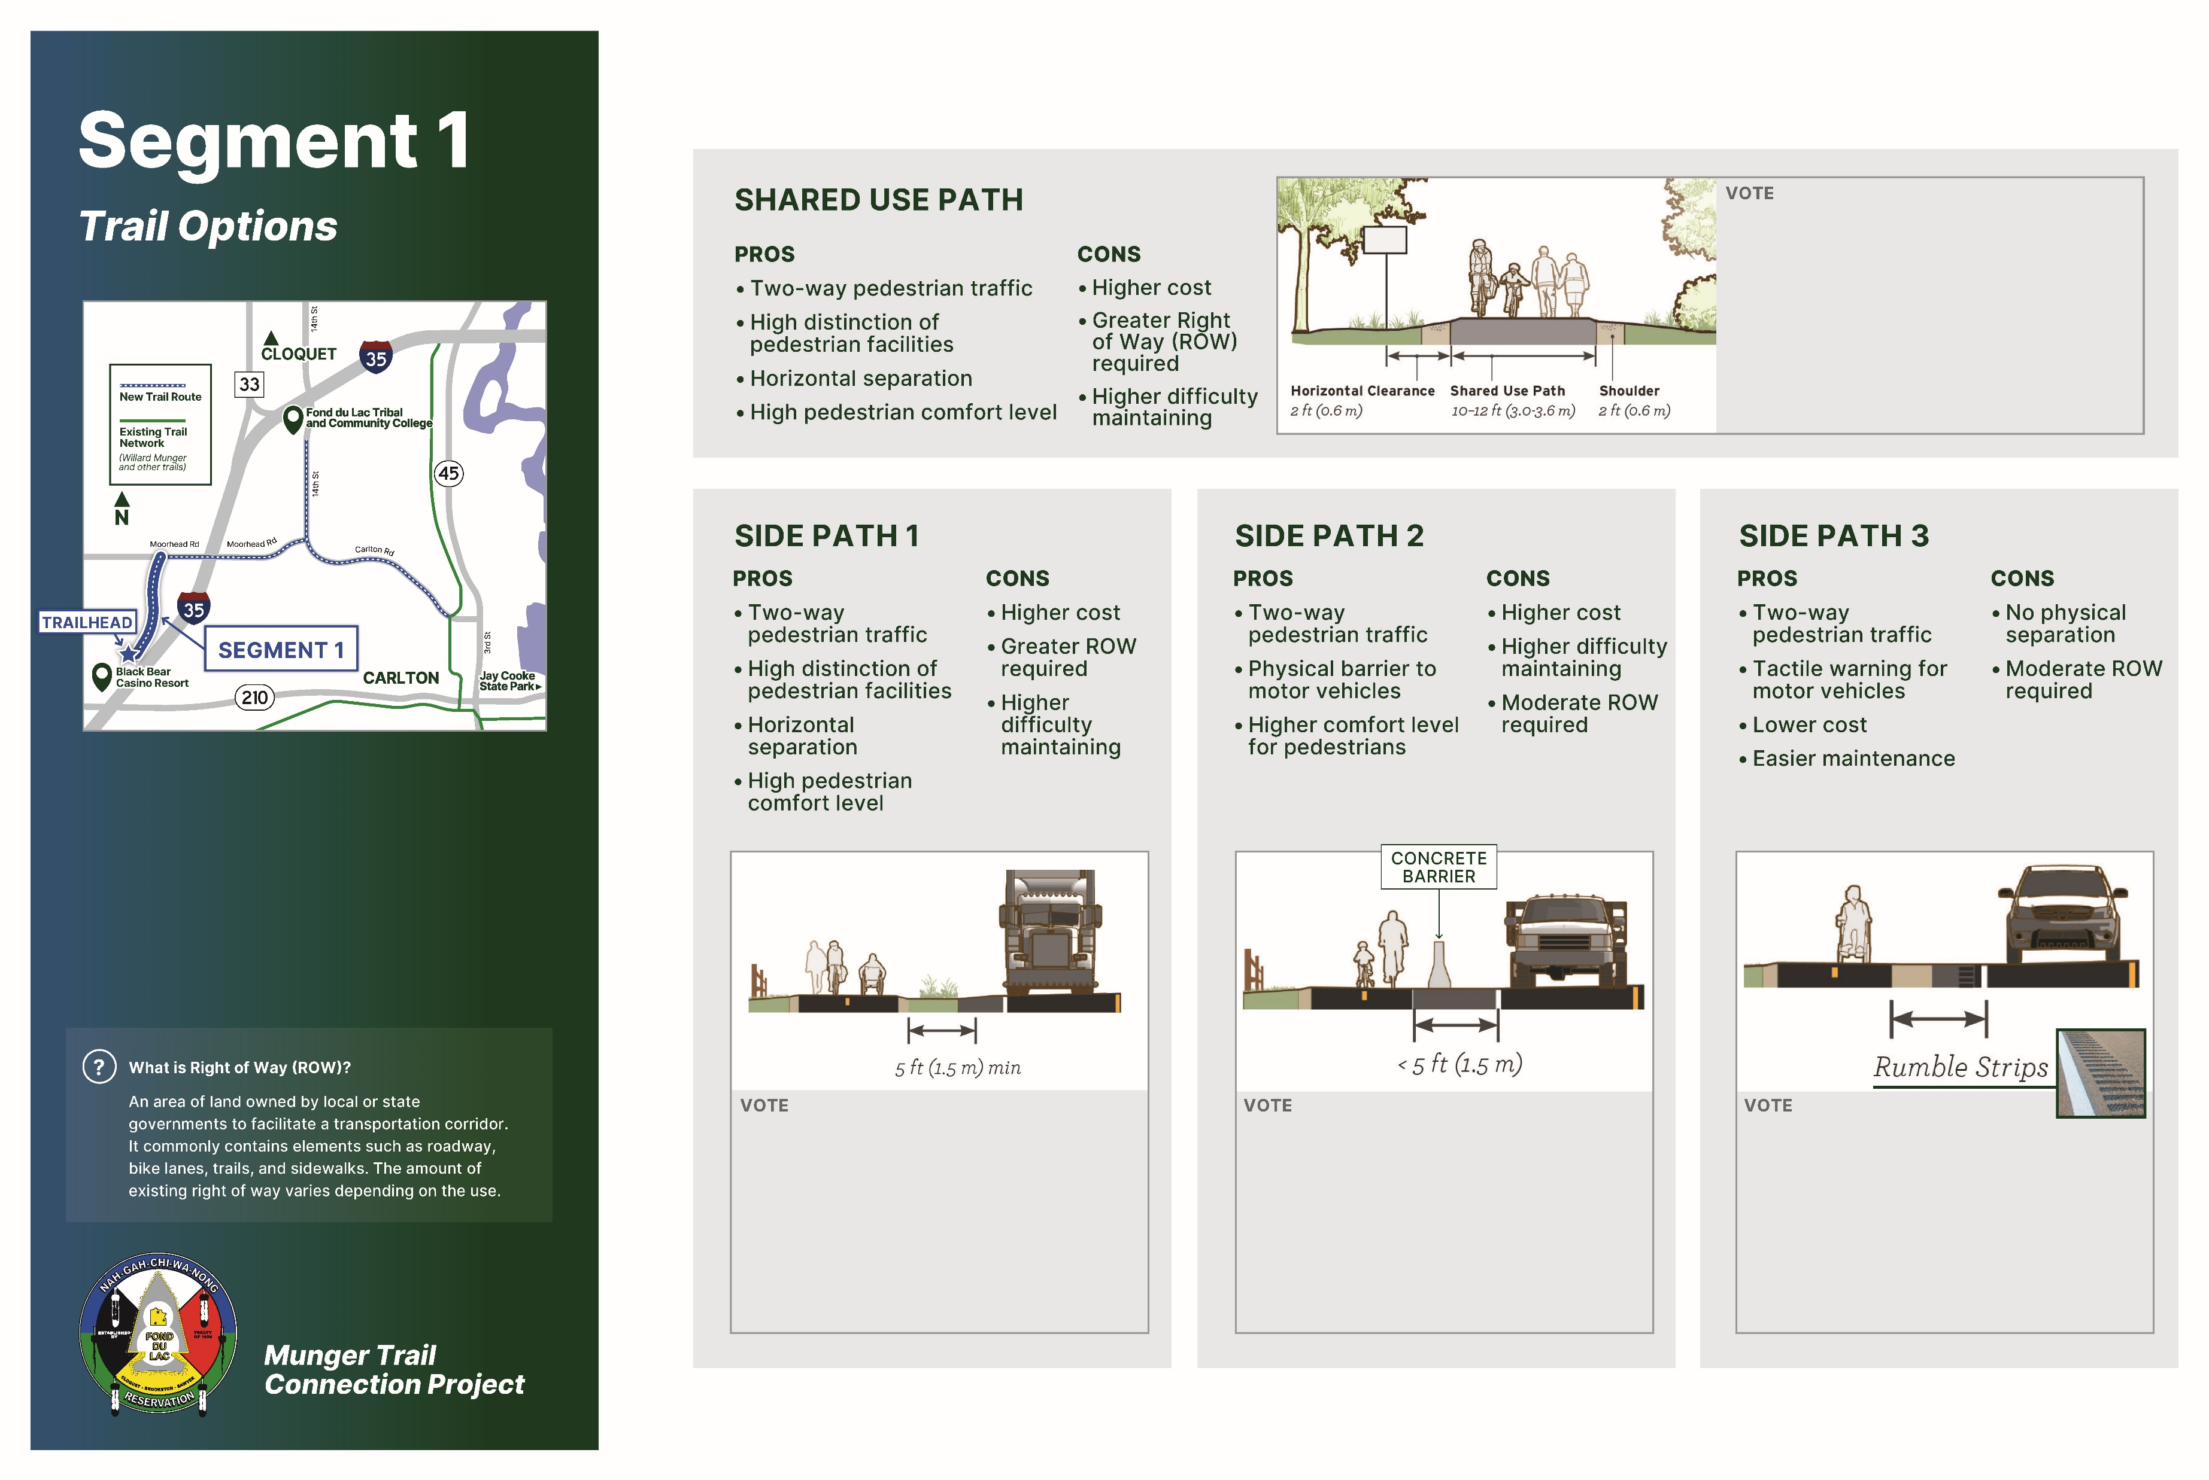

Slide 5
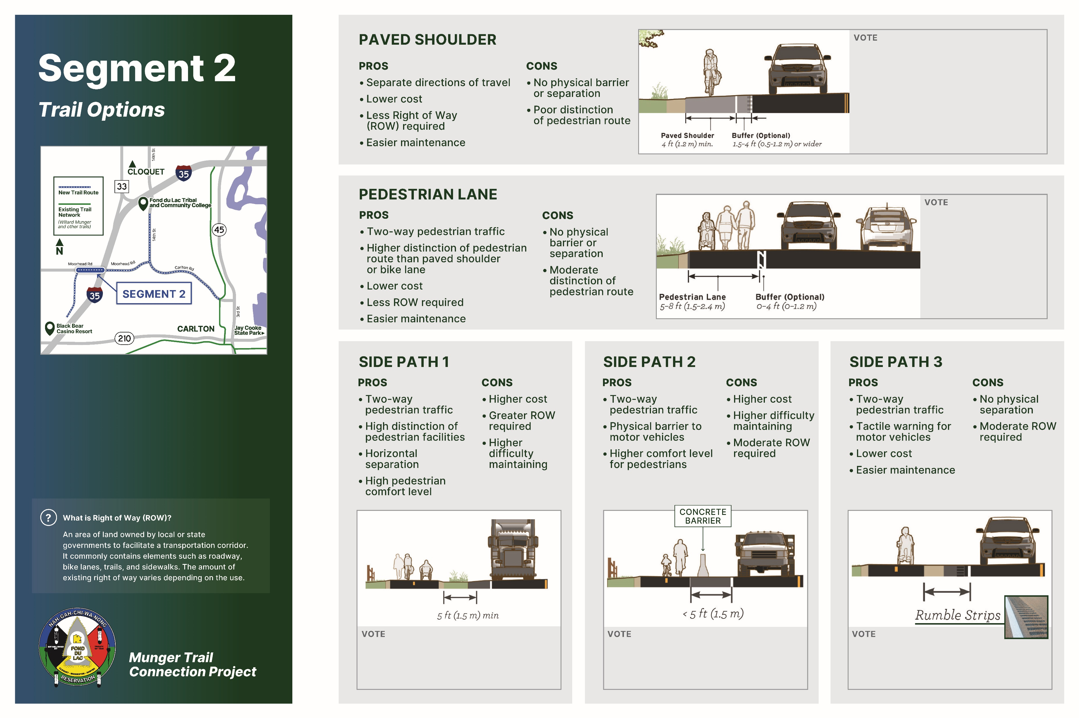

Slide 6
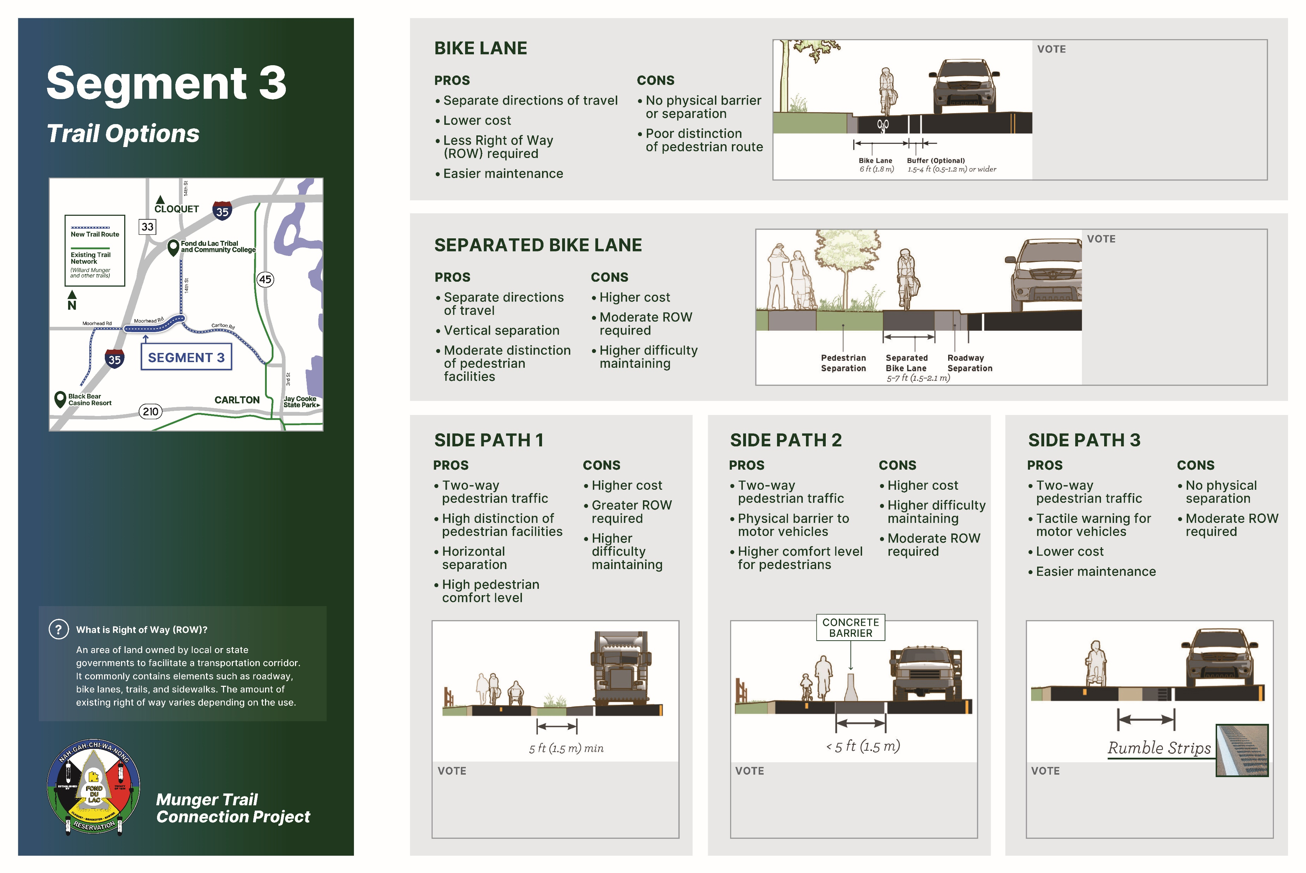

Slide 7


Slide 8
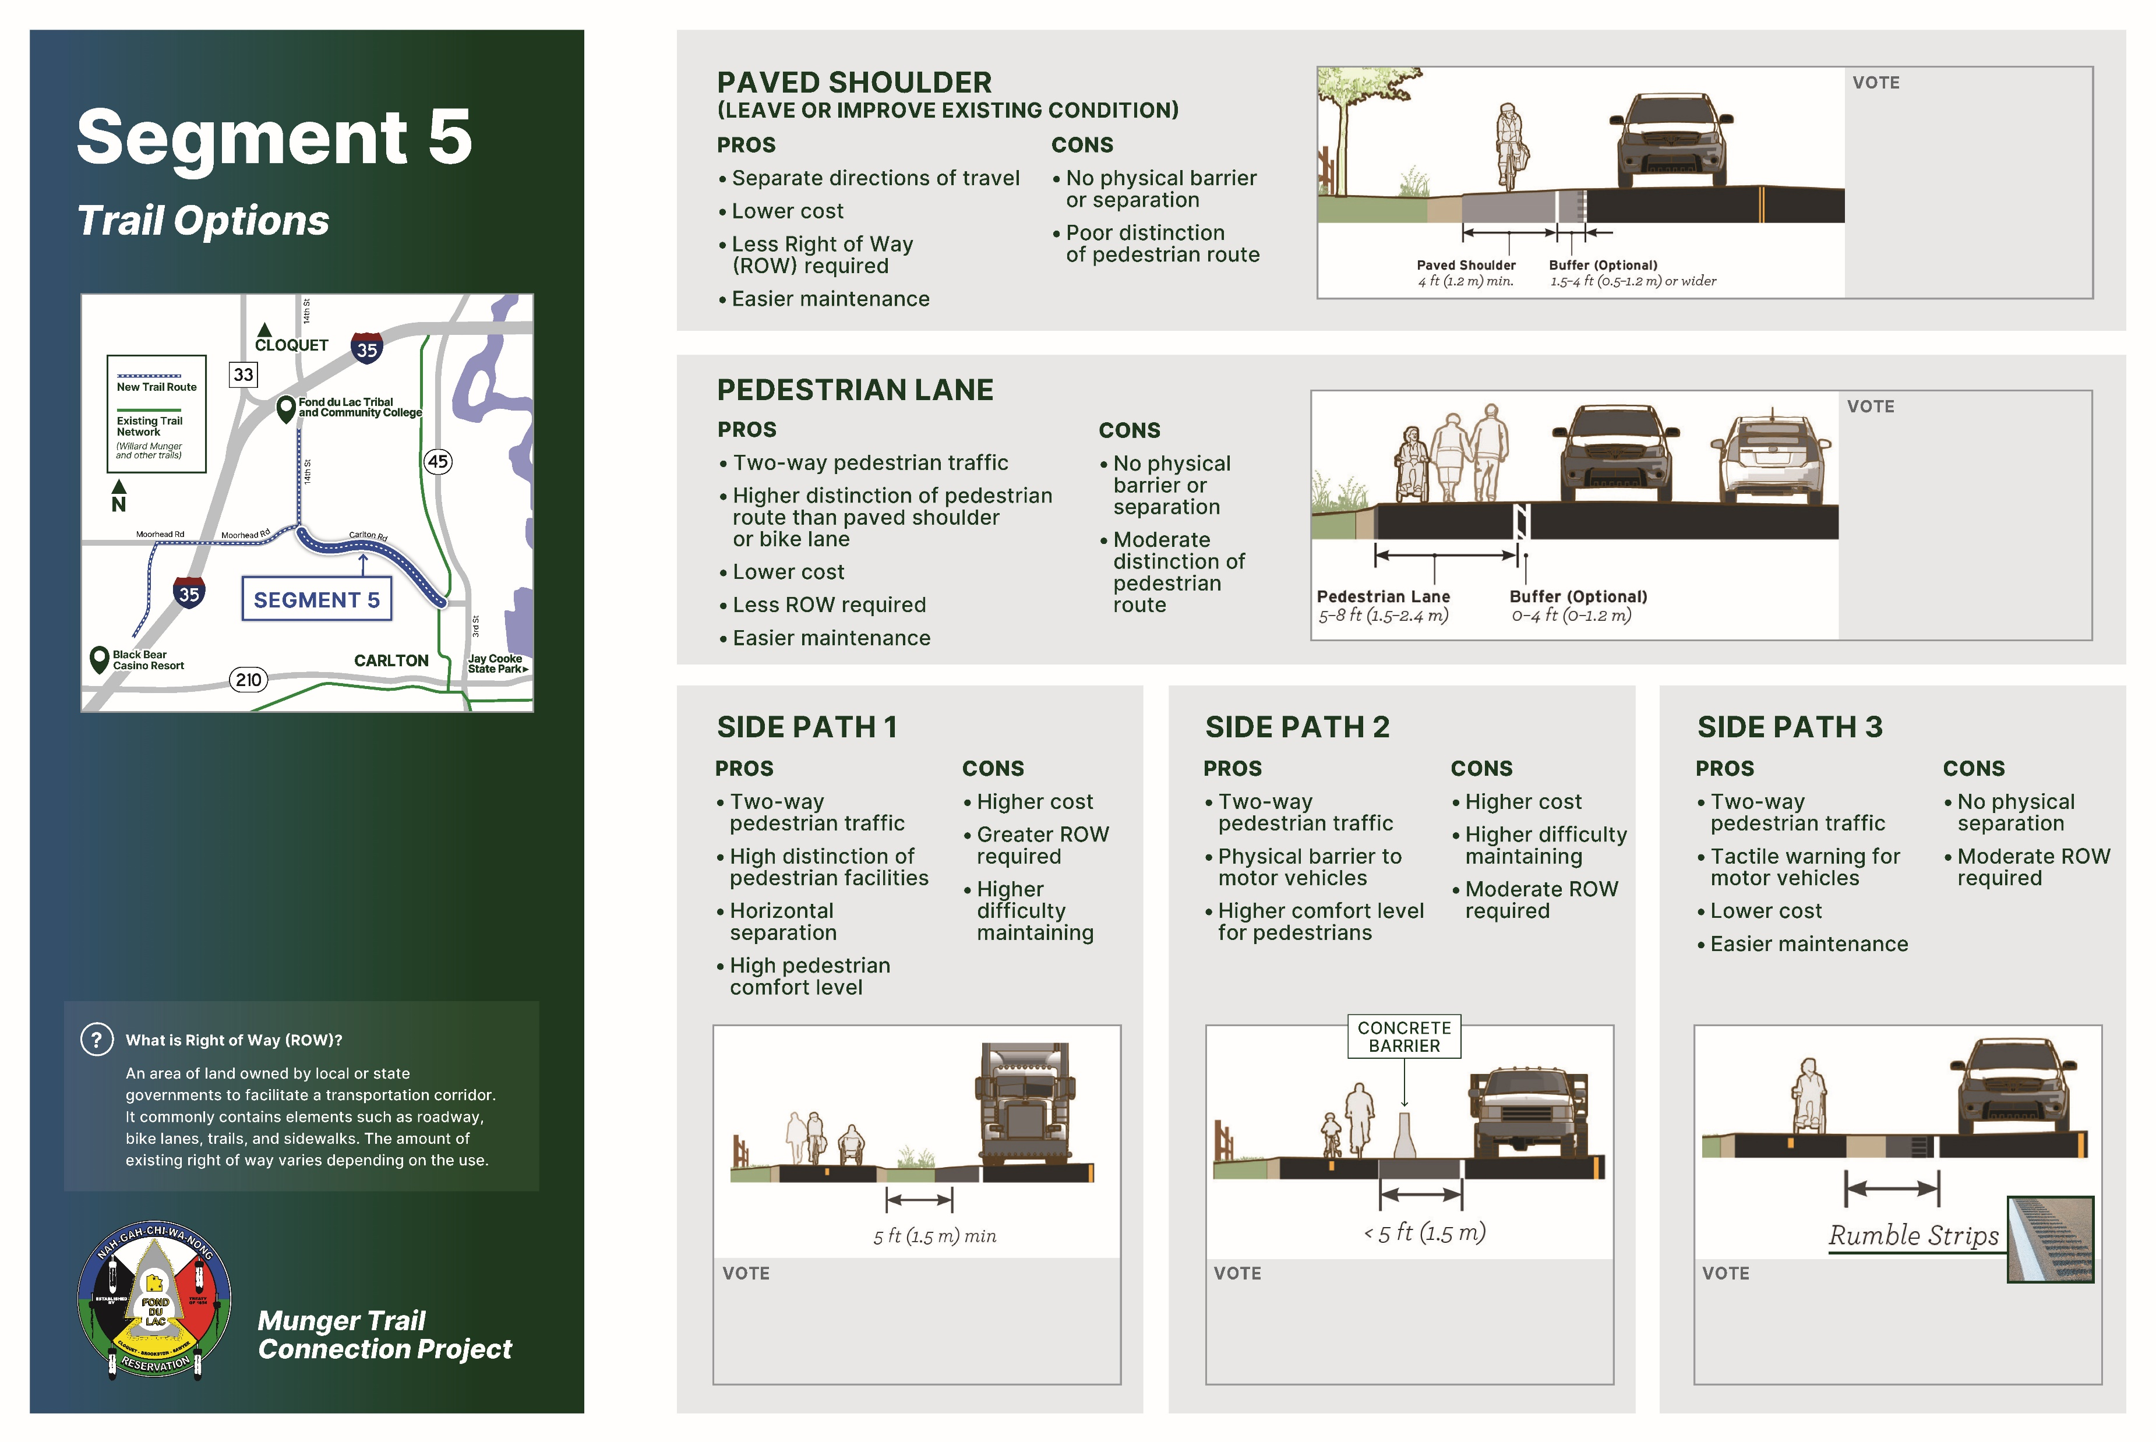

Slide 9
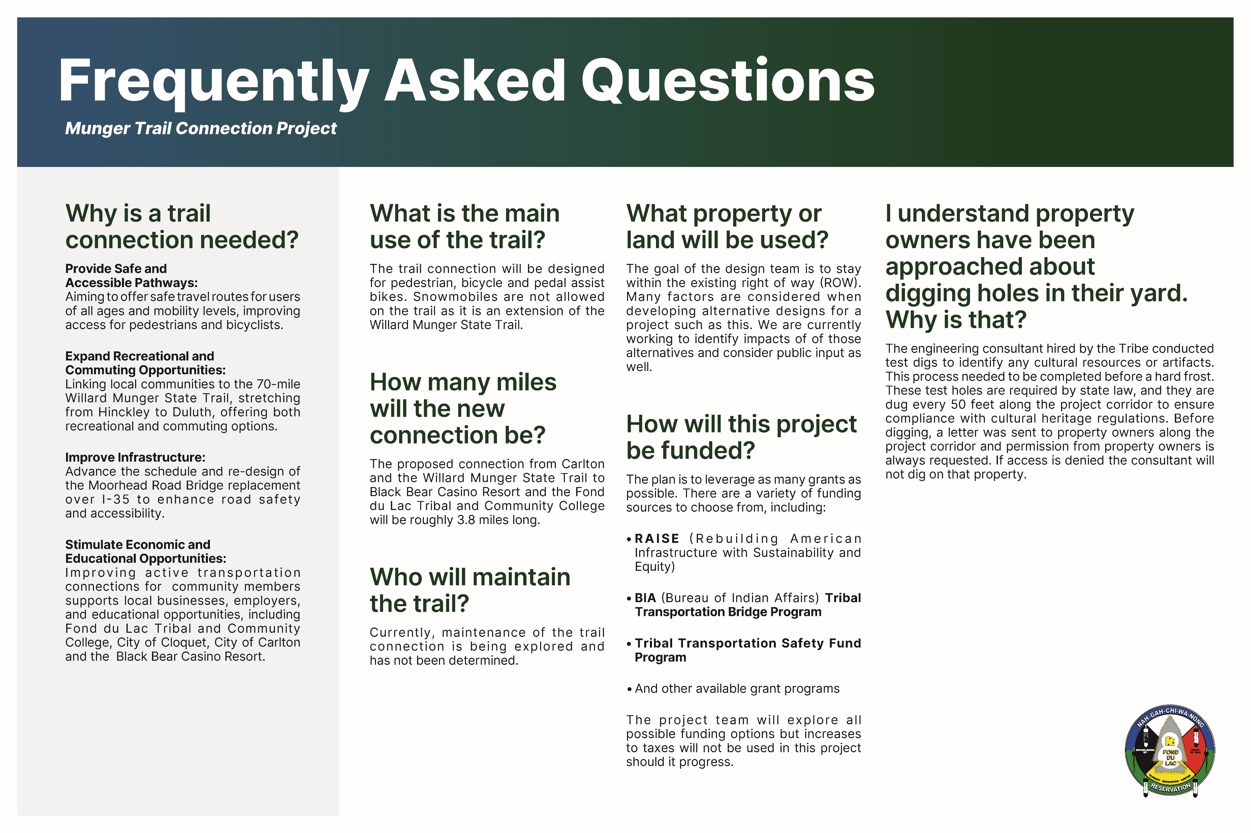

Slide 10
About the Fond du Lac Band of Lake Superior Chippewa:
The Fond du Lac Band of Lake Superior Chippewa is a sovereign Ojibwe nation and one of six bands of the Minnesota Chippewa Tribe. Nagaajiwanaang, “Where the Water Stops,” is the name of the homelands of the Fond du Lac Band at the time of the 1854 Treaty. We retained this name in Ojibwemowin for the present-day Fond du lac Reservation that was established under the 1854 La Pointe Treaty. There are three districts that make up the Fond du Lac Reservation: Bapashkominitigong (Cloquet), Gwaaba’iganing (Sawyer), and Ashkibwaakaaning (Brookston). Today, our Band includes over 4,000 members. We have always been, and continue to be, a proud sovereign Ojibwe nation. We uphold all of our rights retained and agreed to within the 1825, 1826, 1837, 1842, 1847, and 1854 Treaties
For more information on the Fond du Lac Band of Lake Superior Chippewa, please visit the website:
Fond du Lac Band of Lake Superior Chippewa

Slide 11
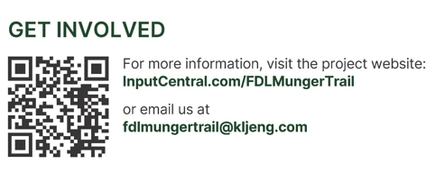
How can I get involved?
To provide feedback on the information you’ve seen here, please visit the project website. Here, you can:
Submit comments through the “Share your feedback!” section.
Use the comment map on the website to share opportunities or concerns by adding a marker to a location along the proposed trail connection.
Sign up for periodic email updates in the “Sign up here to receive project updates” section.
Or, simply send feedback via the email listed below.
Open your camera on your cell phone and hover over the QR code. Click on the link that pops up. This should take you right to the project page.
Miigwech! Thank you! For reviewing the online presentation.

